Slide 1

The Variational Inference Series
Introduction & ELBO

Slide 2
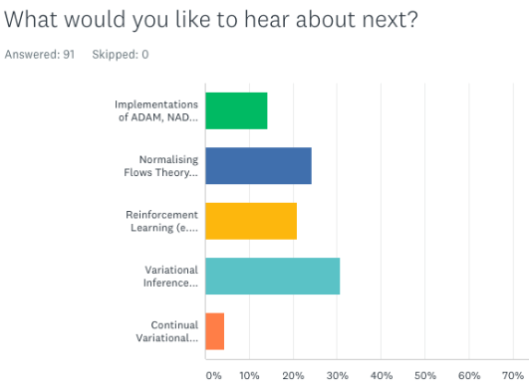

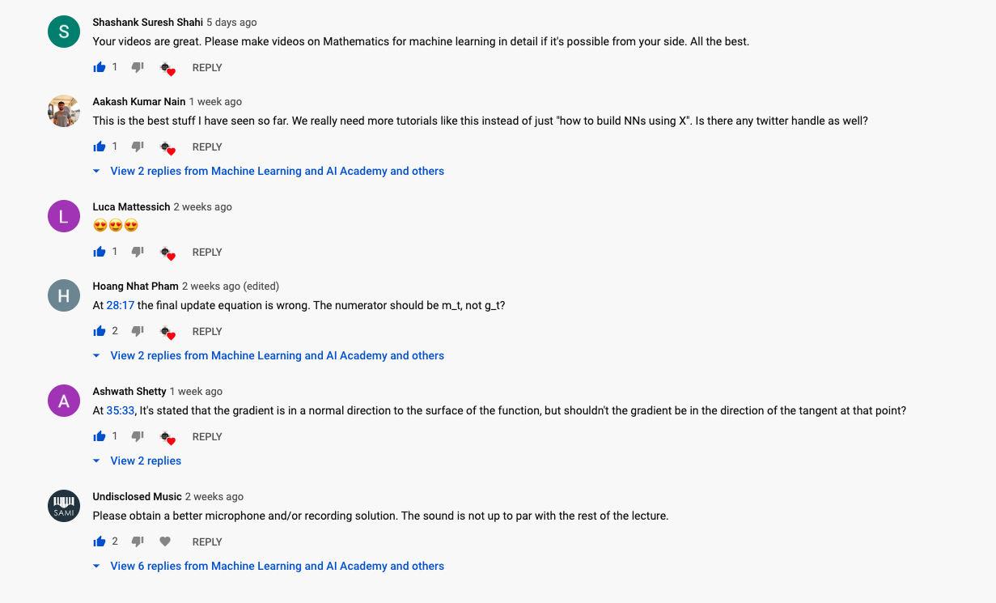
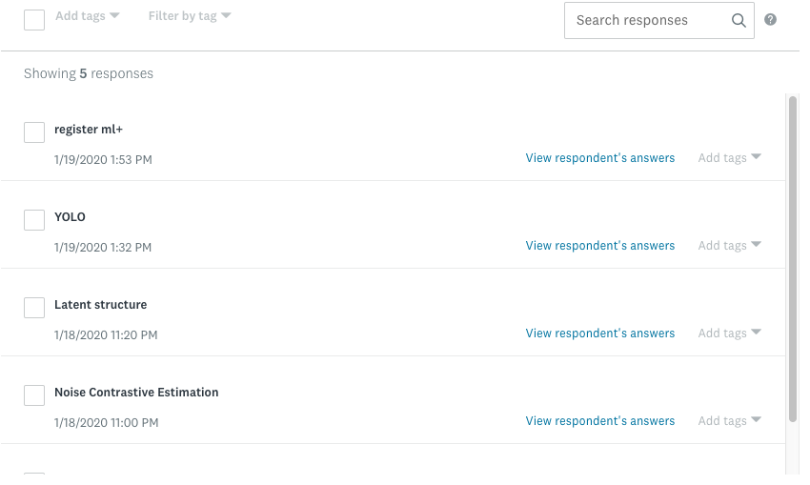
Thanks to all!

Slide 3
Motivation, & Bayesian Modelling

Slide 4
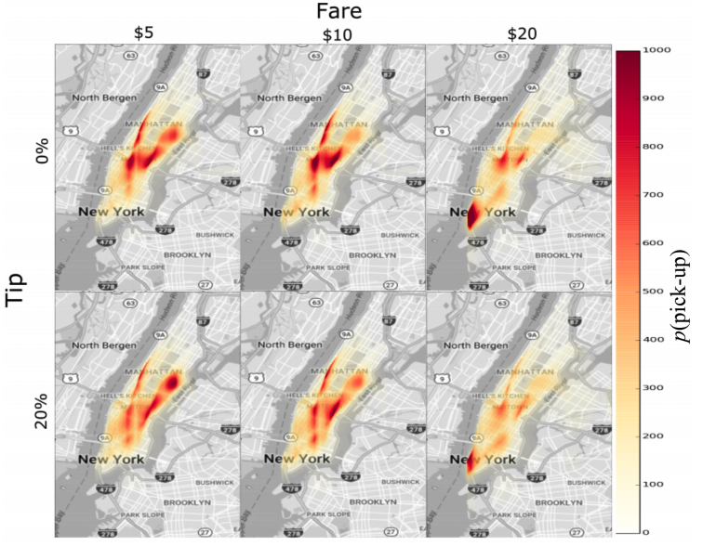

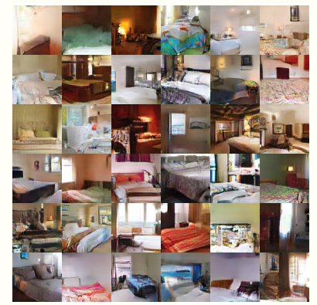
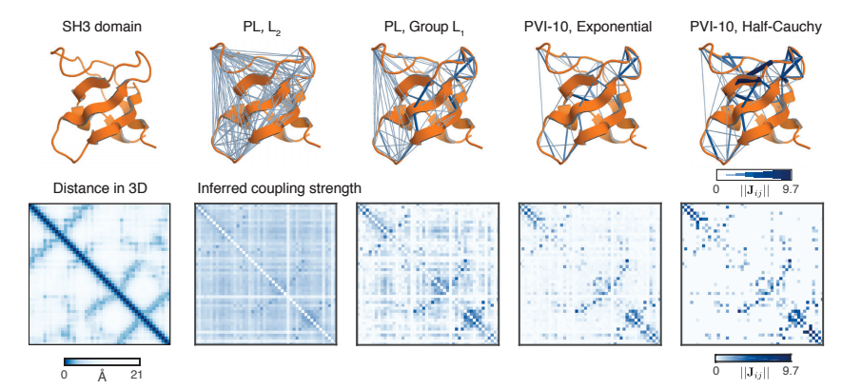
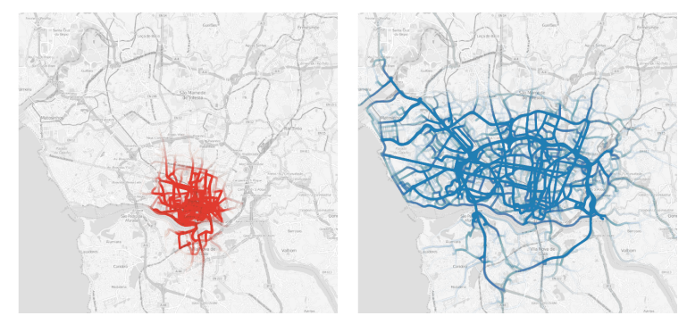
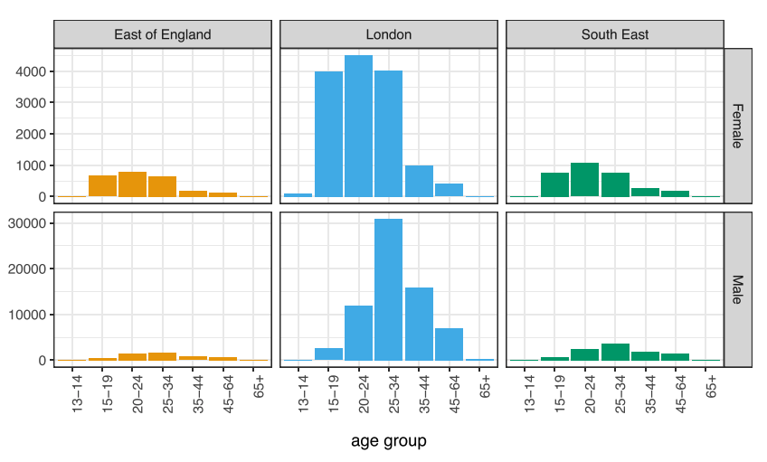
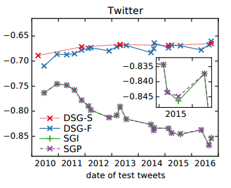
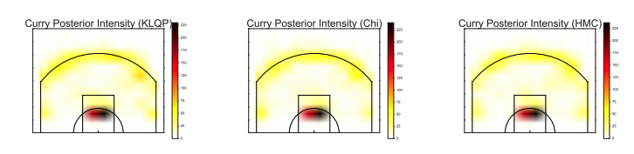
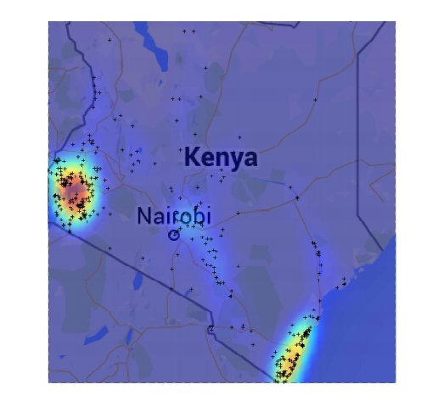
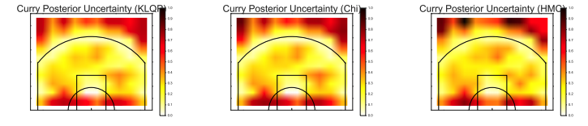
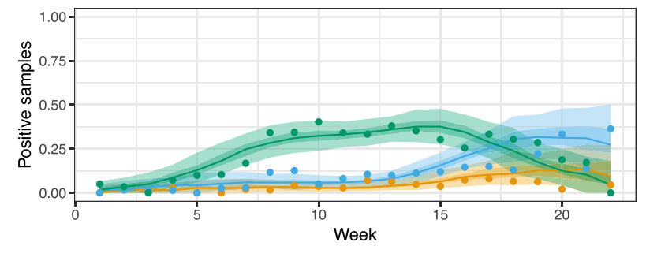
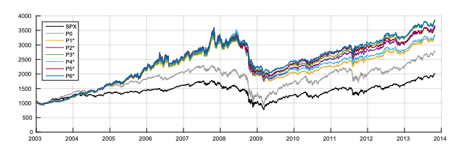
Probabilistic modelling (PM) is widely used in ML ...
[Trippe et. al. 2018]
Training Data
Generated Data
[Kucukelbir et. al. 2016]
[Radford et.a. 2019]
Image generation
Protein Contact Predictions
Taxi and Fare Analysis
[Bamler et. al. 2017]
[Lloyd et. al. 2015]
[Gruber et. al. 2016]
[Dieng et. al. 2017]
Epidemics & Infectious diseases
[Chatzilenna et. al. 2019]
Stock Markets and Time-Series
Sport analysis

Slide 5
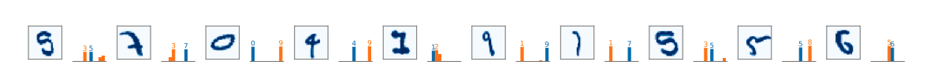
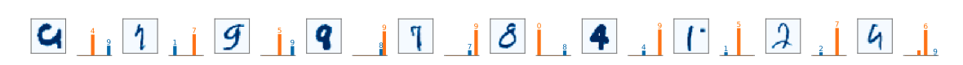
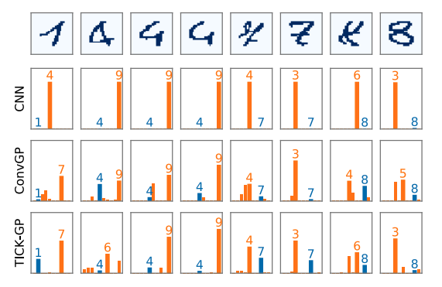
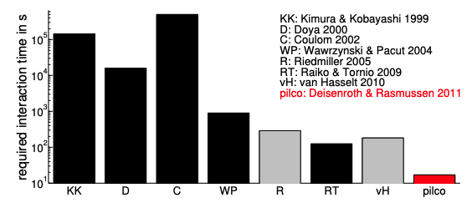
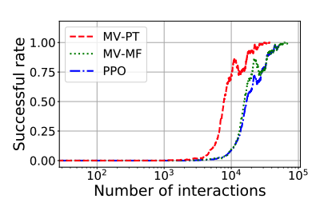
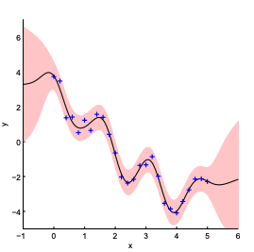
… importantly, PM allows uncertainty estimation ...
… conv network predictions
… bayesian model predictions
[Dutordoir et. al. 2019]
[Deisenroth et.al. 2011]
[Li et.al. 2019]
… we need these uncertainties ...
… I will be careful to using an RNN to invest my money …
… can be useful for reinforcement learning as well

Slide 6
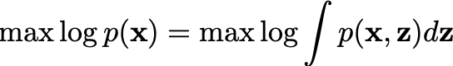
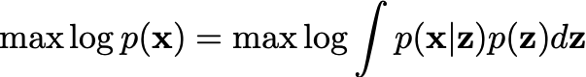
… we represent random variables using graphical models ...
Latent Variable Models allow:
inferring about hidden information not observed in the data
principled way to introduce our beliefs and priors on the phenomena we are trying to estimate
… latent/hidden variables
… conditional dependence relation ...
… observed variables
Our Goal:
… max marginal …
… how to compute this integral ...
… marginalise latents ...

Slide 7
… let’s illustrate the difficulty ...
Let’s take an example of this, where we need to cluster some given data-set, we assume:
We know the total number of cluster
We know that one data point belongs to one cluster
Our Goal:
… max marginal …
… how to compute this integral ...
… marginalise latents ...
… we want to think of clustering from a probabilistic modelling perspective …

Slide 8
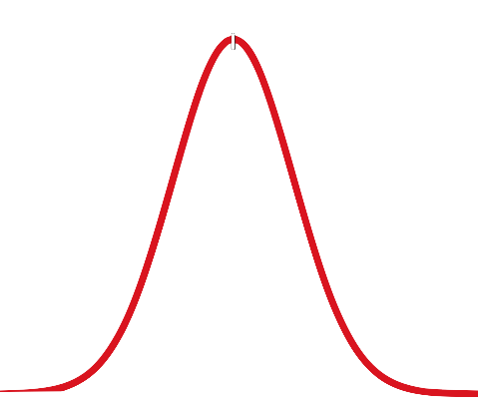
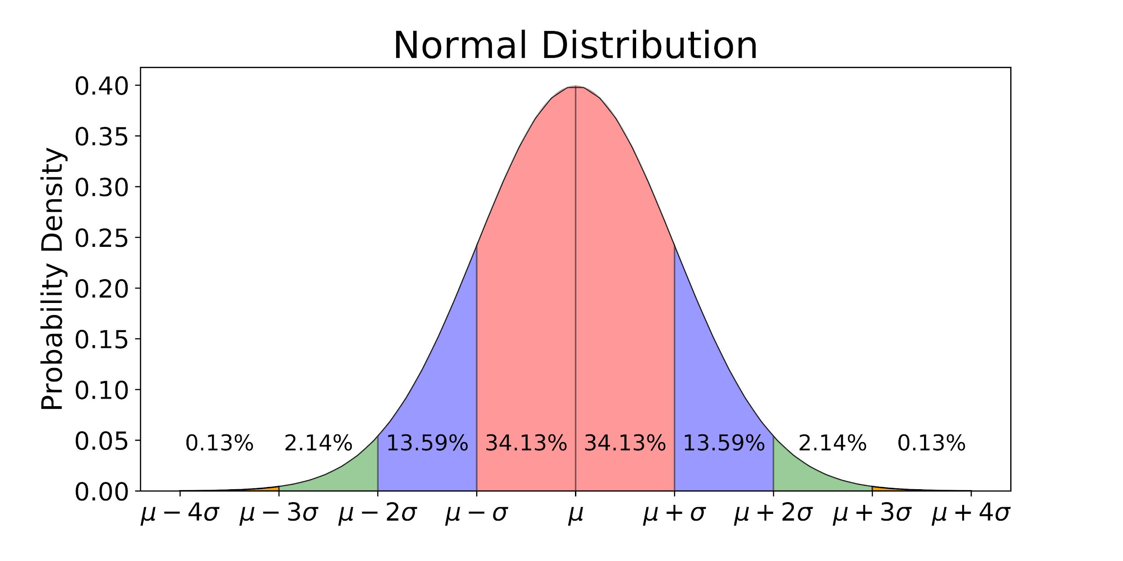
… Bayesian mixture of Gaussians ...
To do so, we assume that there is some hidden/latent process by which this data has been generated, e.g.,
Nature has access to the finite number of clusters
Each cluster data has some distribution
Nature samples a cluster and from that distribution samples a data-point that we saw in the data-set
Nature’s hidden process
… as such, to model nature’s process, we need to be able to deal with two types of random variables:
Continuous Random Variables -- Gaussians (e.g., point locations)
Discrete Random Variables -- Multinomials (e.g., clusters chosen)
Gaussian Distribution
Categorical Distribution

Slide 9
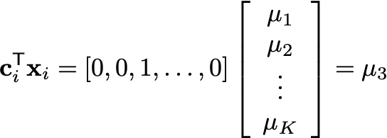
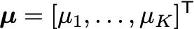
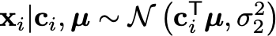
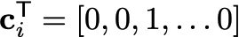
… Bayesian mixture of Gaussians ...
To do so, we assume that there is some hidden/latent process by which this data has been generated, e.g.,
Nature has access to the finite number of clusters
Each cluster data has some distribution
Nature samples a cluster and from that distribution samples a data-point that we saw in the data-set
Nature’s hidden process
… we think of cluster centers as coming from some Gaussian (real-valued random variable)
… we think of cluster choice as a one-hot vector
… data is from a gaussian with some mean ...
… vector of all means
… each data point is assigned to a cluster through an inner product
… one-hot vector

Slide 10
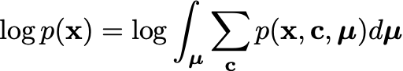

… Bayesian mixture of Gaussians ...
Our Goal:
… max marginal …
… how to compute this integral ...
… marginalise latents ...
Modelling Assumptions:
Our Goal is to Maximise:
… but what is this crazy joint distribution …

Slide 11
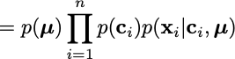
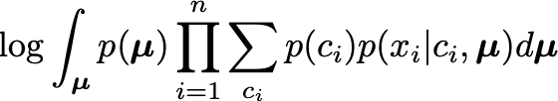
… Bayesian mixture of Gaussians ...
Modelling Assumptions:
Our Goal is to Maximise:
Chain Rule of Probability
… hard to compute

Slide 12
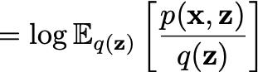
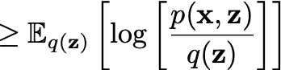
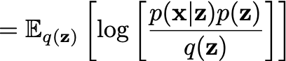
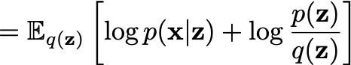
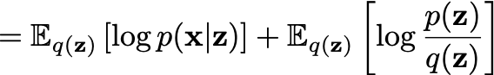

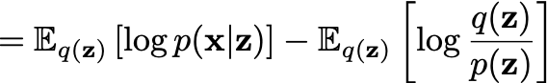
… variational inference helps us deal with these probs ...
… variational inference transforms computing integrals to an optimisation problem which we can solve using standard optimisation techniques, e.g., ADAM...
Evidence Lower-Bound (ELBO)
likelihood
regulariser

Slide 13
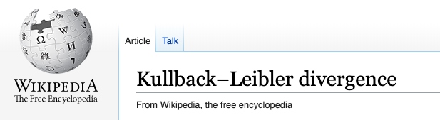
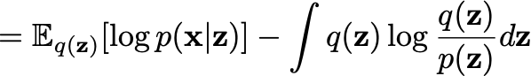
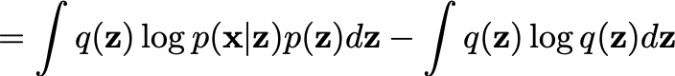
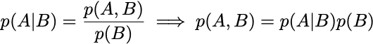
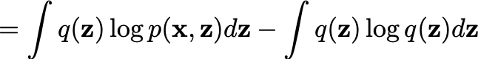
… we can also write our ELBO as ...
.. another way to rewrite the ELBO is simply using the Bayes rule as ...
.. another way to write the ELBO
… applying Bayes Rule

Slide 14
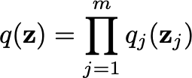
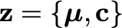
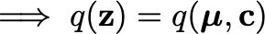
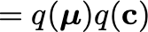
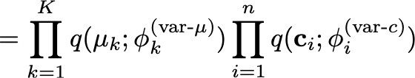
… to finalise the problem, we introduce family of dist’s ...
… to fully specify the problem, we need an additional ingredient of the type of the variational distribution. For now, we assume a mean-field variational distribution that we write as …
… each latent is covered by its own variational factor …
… a distribution over latent variables, trained to maximise ELBO …
Evidence Lower-Bound (ELBO)
… we use this distribution in the ELBO which we need to maximise …
… remember in our example, we have:
… mean-field variational family …
parameterised
Gaussian
parameterised
multinomial

Slide 15
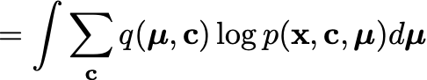
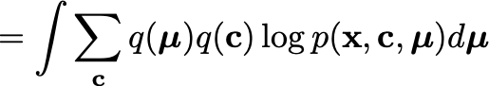
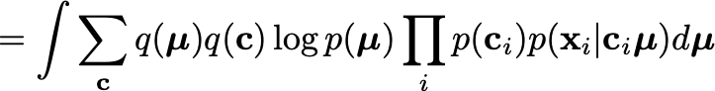
… back to our example …
… let’s write the overall problem that we need to solve for our Bayesian mixture of Gaussians, when using variational inference …
… we need to understand what happens with this optimisation problem …

Slide 16








… back to our example …
prior assumption

Slide 17





… back to our ELBO …
… now, this term ...

Slide 18





… back to our ELBO …
… remember our mean-field approximation:
Variational Assumptions:

Slide 19




… back to our ELBO …
Variational Assumptions:

Slide 20
… back to our ELBO …

Slide 21






… take the gradients …
… we still need to normalise across j ...

Slide 22




… example ...
https://zhiyzuo.github.io/VI/#coordinate-ascent-vi-cavi

Slide 23


… example ...
https://zhiyzuo.github.io/VI/#coordinate-ascent-vi-cavi

Slide 24



… code & resources …
https://github.com/ldeecke/gmm-torch
https://scikit-learn.org/stable/modules/mixture.html
https://zhiyzuo.github.io/VI/#coordinate-ascent-vi-cavi

Slide 25
Grow your future with AI
Please Like & Subscribe!
Machine Learning and AI Academy

